Slide 1
QUEUES
Unit 2.1

Slide 2
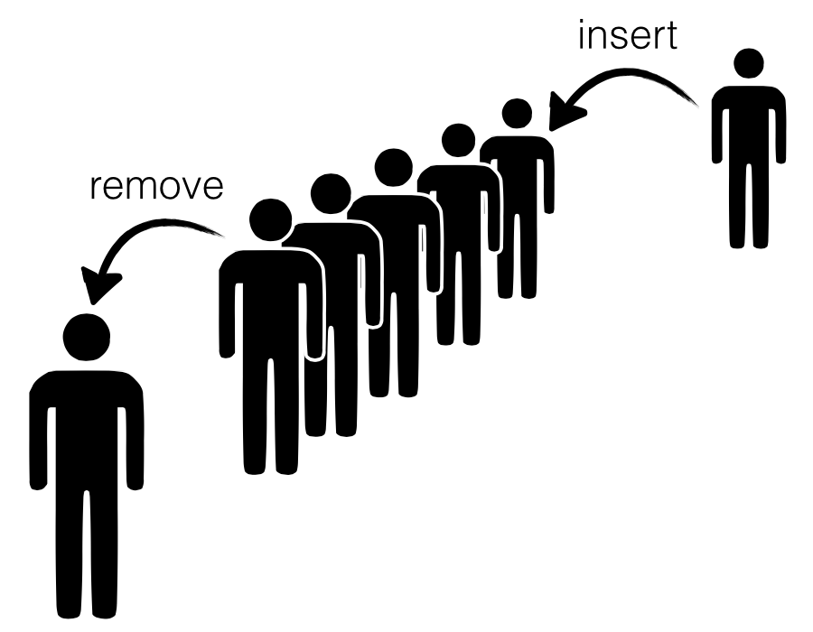
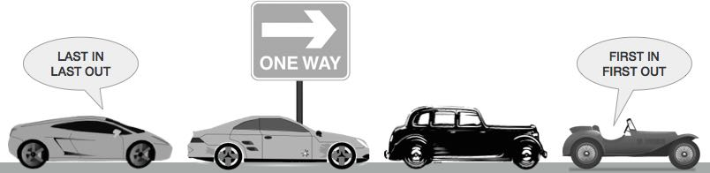
Intro
Movie Hall Ticketing
One Way Traffic

Slide 3
Intro
Queue is a linear list of elements in which deletion of an element can take place at one end, called the front and insertion can take place at the other end, called the rear.
The first element in a queue will be the first one to be removed from the list.
Queues are also called FIFO (First In First Out) i.e. the data item stored first will be accessed first

Slide 4
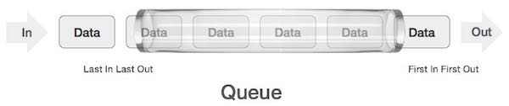
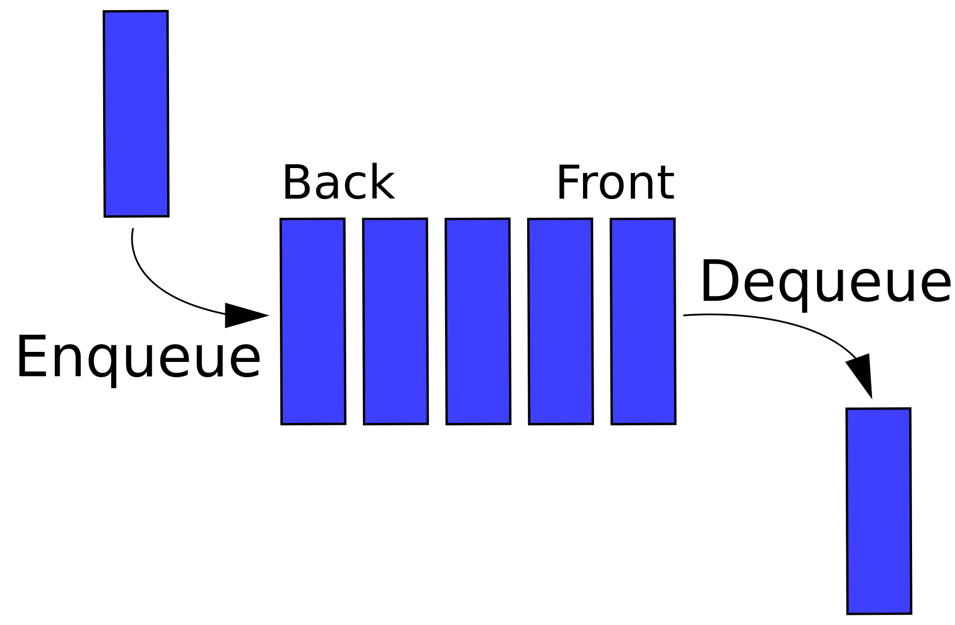
Queue Representation
In queue, we access both ends for different reasons

Slide 5
Applications of queue
Serving requests on a single shared resource, like a printer, CPU task scheduling etc.
In real life, Call Center phone systems will use Queues, to hold people calling them in an order, until a service representative is free.
Handling of interrupts in real-time systems. The interrupts are handled in the same order as they arrive, First come first served.

Slide 6
The queue as an ADT
A queue q of type T is a finite sequence of elements with the operations
  MakeEmpty(q): To make q as an empty queue
  IsEmpty(q): To check whether the queue q is empty. Return true if q is empty, return false otherwise.
  IsFull(q): To check whether the queue q is full. Return true in q is full, return false otherwise.
  Enqueue(q, x): To insert an item x at the rear of the queue, if and only if q is not full.
  Dequeue(q): To delete an item from the front of the queue q if and only if q is not empty.
  Traverse (q): To read entire queue that is display the content of the queue.

Slide 7
Enqueue Operation
Queue maintains two data pointers, front and rear
The following steps should be taken to enqueue(insert) data into queue –
  Step 1 – Check if queue is full
  Step 2 – if queue is full
  produce overflow error and exit
  else
  increment rear pointer to point next empty space
  and add data element to the queue location, where rear is pointing
  Step 3 - return success

Slide 8
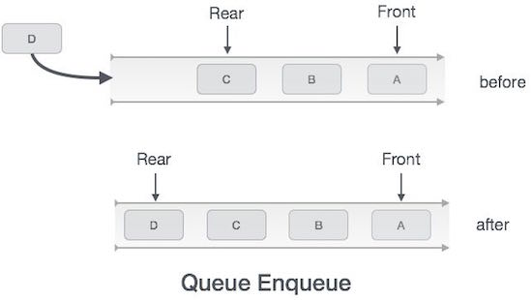

Slide 9
Implementation of enqueue()
int enqueue(int data) {
if(isfull()) {
return 0;
}
rear = rear + 1;
queue[rear] = data;
return 1;
}

Slide 10
Dequeue Operation
Accessing data from queue is a process of two steps
  Access the data from where front is pointing
  And remove the data after access
The following steps are taken to perform dequeue operation
  Step 1 – Check if queue is empty
  Step 2 – if queue is empty
  produce underflow error and exit
  else
  access data where front is pointing, increment front pointer to point next available data element
  Step 3 – return success.

Slide 11
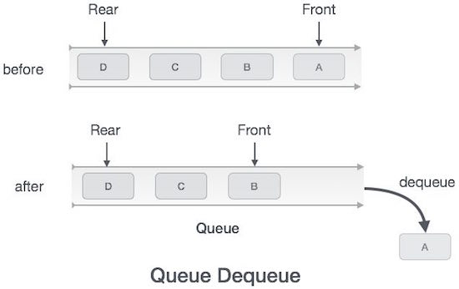

Slide 12
Implementation of dequeue()
int dequeue() {
if(isempty()) {
return 0;
}
int data = queue[front];
front = front + 1;
return data;
}

Slide 13
Implementation of queue
There are two techniques for implementing the queue:
  Array implementation of queue (static memory allocation)
    Linear array implementation (Linear Queue)
    Circular array Implementation (Circular queue)
  Linked list implementation of queue (dynamic memory allocation)

Slide 14
Array implementation of queue
The easies way of implementing a queue is by using an Array.
Initially head(FRONT) and the tail(REAR) of the queue points at the first index of the array.
As we add elements to the queue, we can either move tail before adding another item or we can move the tail after adding the item, while the head remains at the first index.

Slide 15
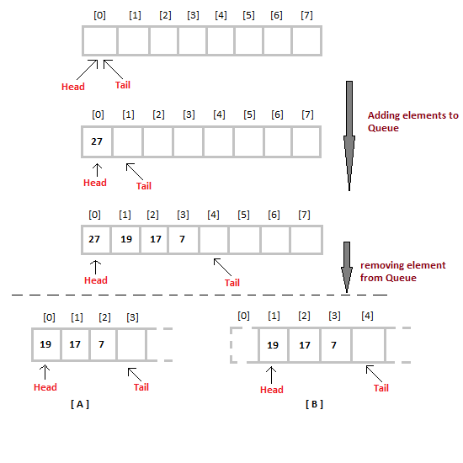
Linear Queue

Slide 16
Linear Queue
Insertion of an item in queue | Deletion of an item from queue
Initialize front=0 and rear=-1 if rear>=MAXSIZE-1 print “queue overflow” and return else set rear=rear+1 queue[rear]=item 2. end | 1. if rear<front print “queue is empty” and return else item=queue[front++] 2. end

Slide 17
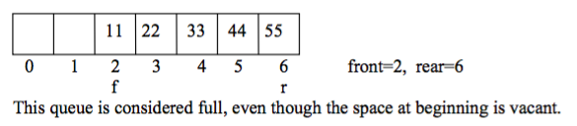
Problems with Linear queue implementation
Both rear and front indices are increased but never decreased.
As items are removed from the queue, the storage space at the beginning of the array is discarded and never used again.
Wastage of the space is the main problem with linear queue which is illustrated by the following example.

Slide 18
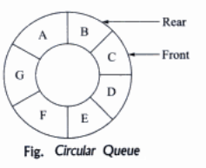
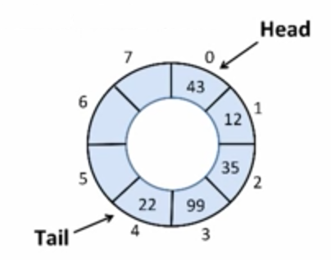
Circular queue
A queue where the start and end of the queue are joined together.
A circular queue is one in which the insertion of a new element is done at very first location of the queue if the last location of the queue is full.

Slide 19
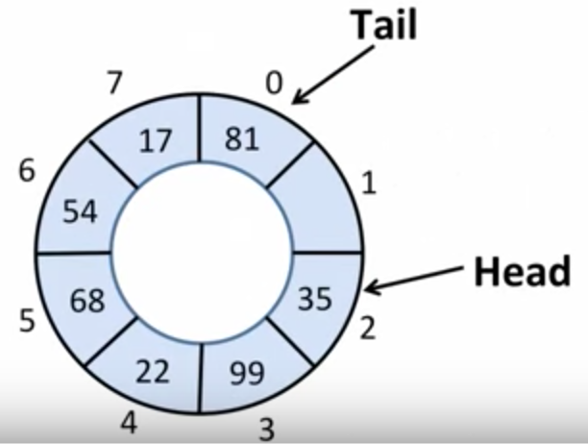
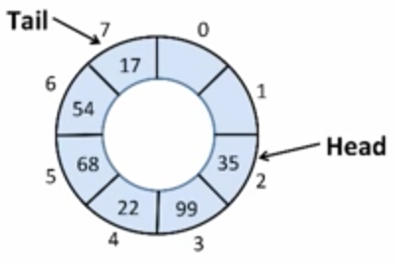
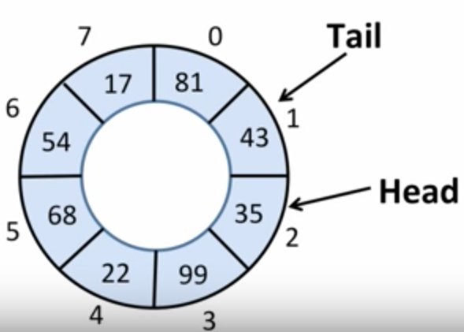

Slide 20
Circular queue
isFull() | IsEmpty
If HEAD == (Tail % MAX) + 1 Then Full <- True; Else Full <- False; If they have caught up to each other, then it’s full | If Head ==Tail Then Full <- True; Else Full <- False;

Slide 21
Circular queue
Enqueue operation | Dequeue operation
Step 1. start Step 2. if (front == (rear+1)%max) Print error “circular queue overflow “ Step 3. else{ rear = (rear+1)%max Q[rear] = element; } Step 4. stop | Step 1. start Step 2. if isEmpty() == True Print error “Queue is Empty“ Step 3. else{ element = Q[front] front = (front + 1) % max } Step 4. stop

Slide 22
References
https://www.cs.cmu.edu/~adamchik/15-121/lectures/Stacks%20and%20Queues/Stacks%20and%20Queues.html
http://www.tutorialspoint.com/data_structures_algorithms/dsa_queue.htm
http://www.studytonight.com/data-structures/queue-data-structure
https://www.youtube.com/watch?v=g9su-lnW2Ks
https://www.youtube.com/watch?v=ia__kyuwGag
https://www.quora.com/What-is-a-circular-queue
http://basicdatastructures.blogspot.com/2007/12/circular-queue-data-structure.html
http://btechsmartclass.com/DS/U2_T10.html
http://scanftree.com/Data_Structure/circular-queue
http://btechsmartclass.com/DS/U2_T10.html

